Slide 1


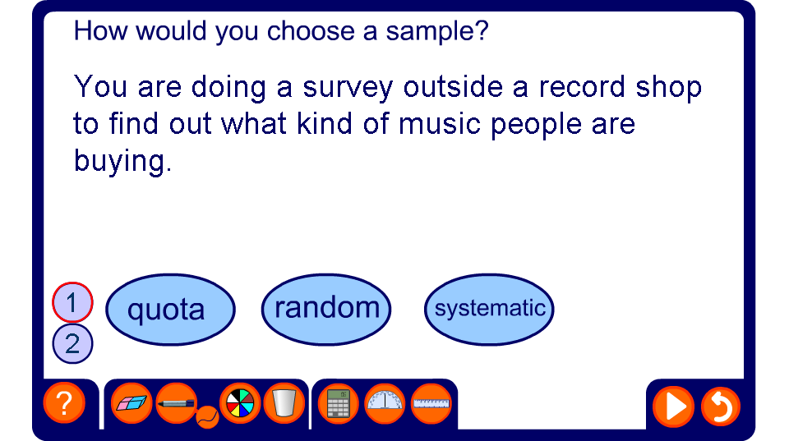


Different sampling methods
Notes:
Choose using the numbered level buttons whether you want to include stratified sampling or not, depending on the level of your pupils. Pupils should decide on which sampling method is being used. There should be discussion first, then they could write their answers on mini whiteboards to help you evaluate their understanding. They should also be asked to justify their decisions. Clicking on the “more” box will generate the reasoning behind the answer, which you and your pupils may not always agree with- there are not always straightforward solutions to these problems.

